Slide 1
CAP7001:
Data Communication and Networking
Unit-I
Addressing Mechanisms

Slide 2
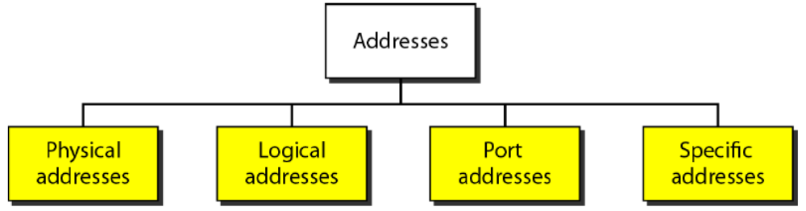
Addressing Mechanisms
Four address levels used
Physical, Logical, Port, Specific
Physical address for network nodes
Logical address links to network
Port addresses identify processes

Slide 3
Physical Address
Also called link address
Defined by LAN or WAN
Size varies by network type
Example: Ethernet uses 48-bit
Can be unicast, multicast, broadcast

Slide 4
Logical Address
For software networking use
32-bit IPv4 logical address
Example IPv4: 132.24.75.9
Fixed from source to destination
Used for routing and addressing

Slide 5
Port Addresses
Logical address for programs
Identifies sender and receiver
Supports multiple apps simultaneously
Common in TCP/IP connection
Example: 16-bit decimal number 753

Slide 6
Application-Specific Addresses
Designed for specific applications
User-friendly addressing formats
Easier for users to remember
Maps to underlying network addresses
Enhances usability of services

Slide 7
THANK YOU

